Slide 1

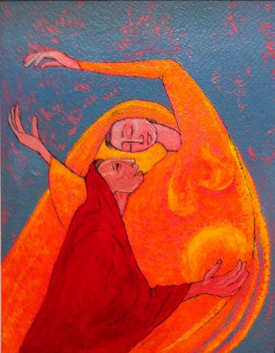
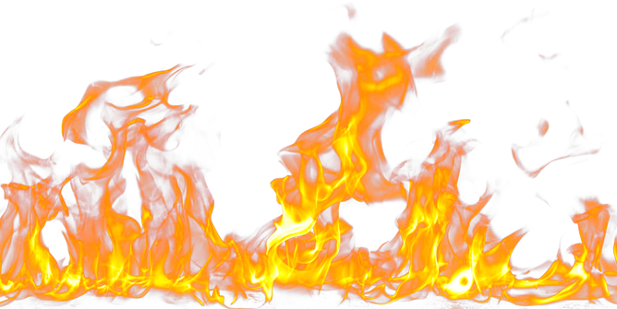
A FIRST CALL COHORT LED ADVENT WORSHIP
FEEL THE BURN
We often view fire as a bad thing. Something to be avoided. At worst, faith can be viewed as fire insurance. But Scriptures describe God as a purifying fire. The fire that spoke to Moses out of the burning bush. The God who guided the Israelites in a pillar of flame, and was with Shadrach, Meshach, and Abednego in the fire. Advent is a season of purification. A time we encounter the fiery presence of our God who refines us. In many of our churches, it can feel like we’re already holding the ash in our hands. Yet, this ash can also be a sign of new life. How can we receive this fire as a gift? May God even be calling us to stoke the fire? The prophet Malachi and Mother Mary invite us this season to ponder this work of God anew.

Slide 2
GATHERING AROUND THE WORD
One: Arise, shine; for your light has come, and the glory of the Lord has risen upon you. For darkness shall cover the earth, and thick darkness the peoples; but the Lord will arise upon you, and his glory will appear over you.
Many: Nations shall come to your light, and kings to the brightness of your dawn.
One: The sun shall no longer be your light by day, nor for brightness shall the moon give light to you by night; but the LORD will be your everlasting light, and your God will be your glory.
Many: Your sun shall no more go down, or your moon withdraw itself; for the Lord will be your everlasting light, and your days of mourning shall be ended.
All: I am the LORD; in its time I will accomplish it quickly.
LITUGIST: REV. JOE SVANCARA

Slide 3
OPENING HYMN
#13 “PREPARE THE WAY” (PH)

Slide 4
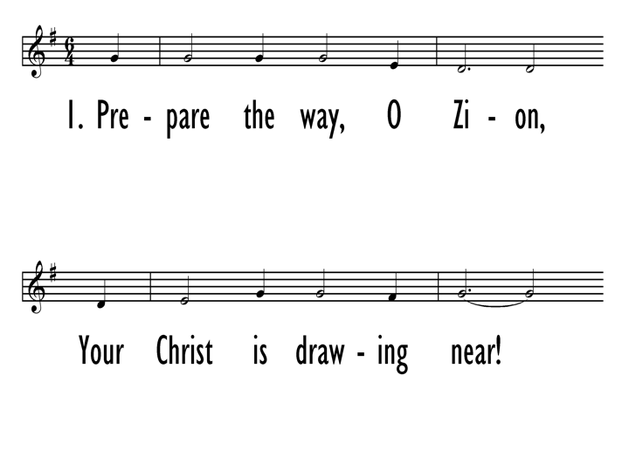

Slide 5
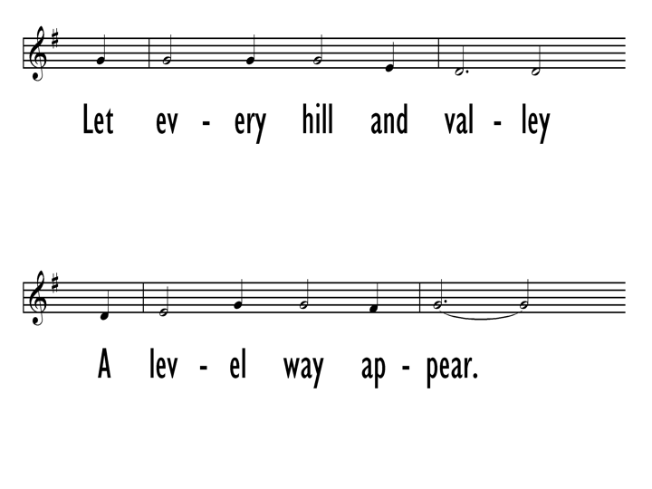

Slide 6
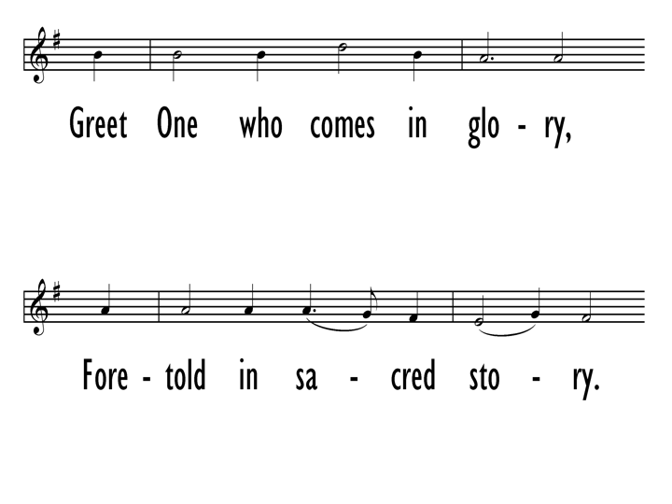

Slide 7
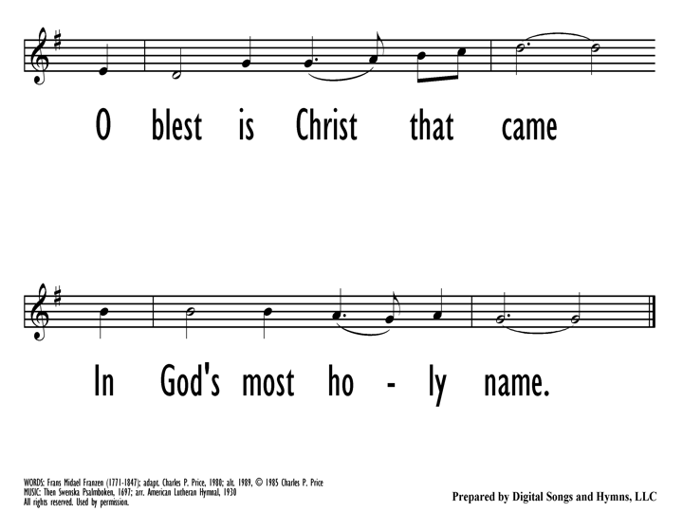

Slide 8
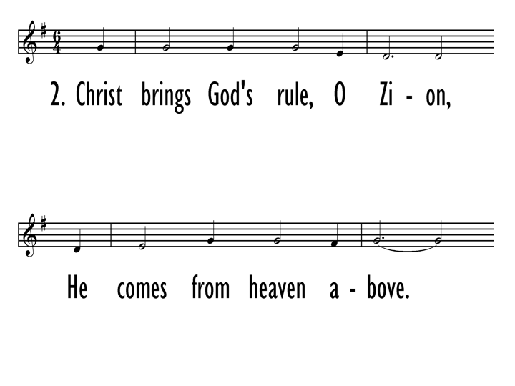

Slide 9
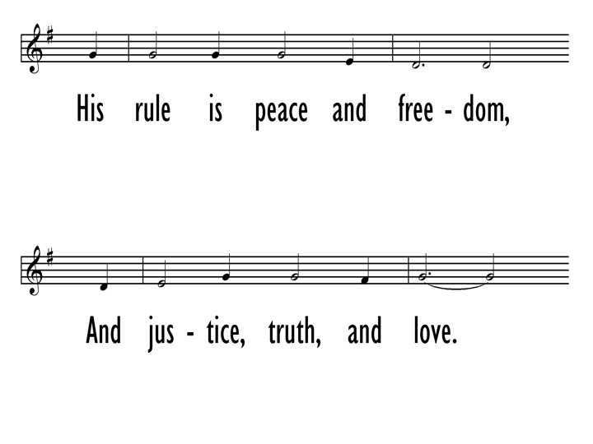

Slide 10
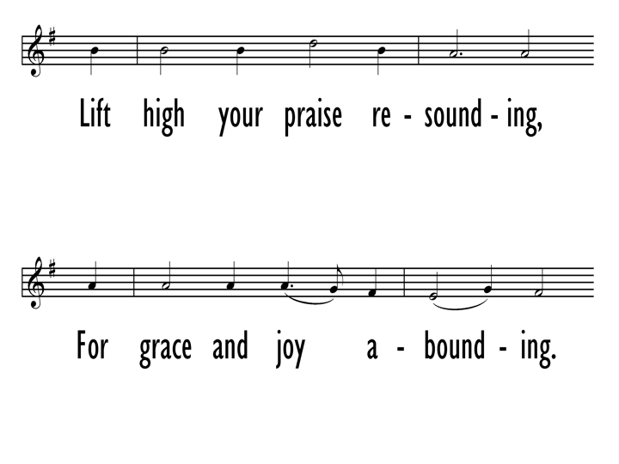

Slide 11
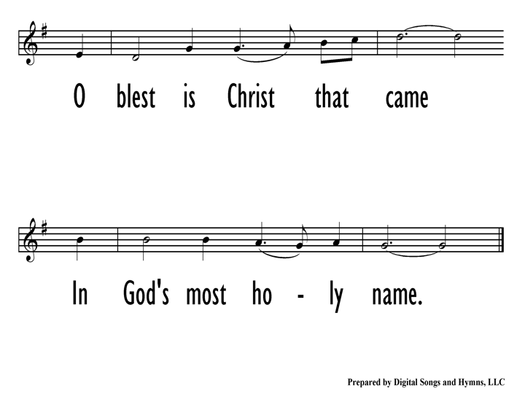

Slide 12
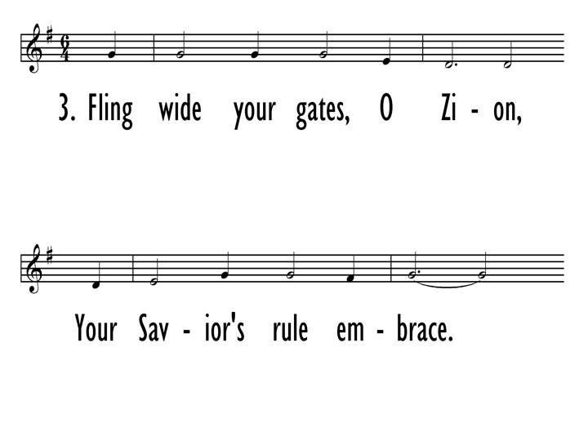

Slide 13
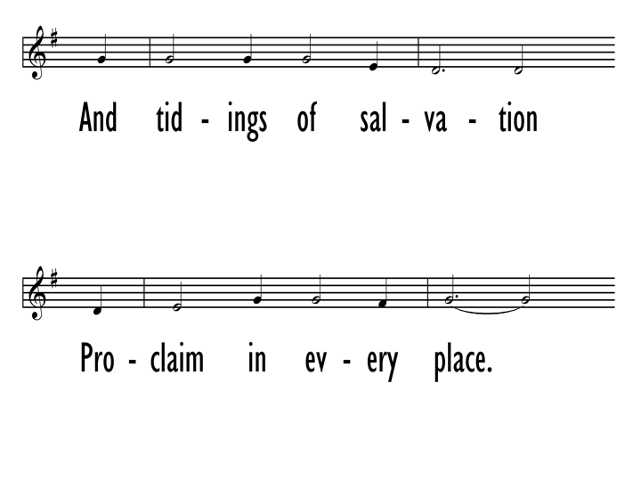

Slide 14
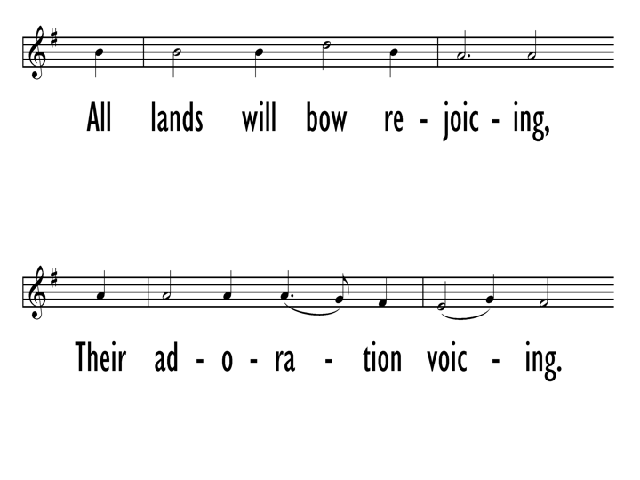

Slide 16

MALACHI 3:1-4
The Old Testament lesson is from the prophet Malachi, the 3rd chapter,
beginning at the 1st verse:
See, I am sending my messenger to prepare the way before me, and the Lord whom you seek will suddenly come to his temple. The messenger of the covenant in whom you delight—indeed, he is coming, says the Lord of hosts. But who can endure the day of his coming, and who can stand when he appears?
For he is like a refiner’s fire and like washers’ soap; he will sit as a refiner and purifier of silver, and he will purify the descendants of Levi and refine them like gold and silver, until they present offerings to the Lord in righteousness. Then the offering of Judah and Jerusalem will be pleasing to the Lord, as in the days of old and as in former years.
The Word of the Lord. Thanks be to God.
Homily by Rev. Hylden

Slide 17
LUKE 1:46-55
The Holy Gospel according to St. Luke, the 1st chapter, beginning at the 46th verse:
Glory to you, O Lord.
And Mary said, “My soul magnifies the Lord, and my spirit rejoices in God my Savior,
for he has looked with favor on the lowly state of his servant. Surely from now on all generations will call me blessed, for the Mighty One has done great things for me, and holy is his name; indeed, his mercy is for those who fear him from generation to generation. He has shown strength with his arm; he has scattered the proud in the imagination of their hearts. He has brought down the powerful from their thrones
and lifted up the lowly; he has filled the hungry with good things and sent the rich away empty. He has come to the aid of his child Israel, in remembrance of his mercy, according to the promise he made to our ancestors, to Abraham and to his descendants forever.”
The Gospel of the Lord. Praise to you, O Christ.
Homily by Rev. Kathryn Ophardt

Slide 18
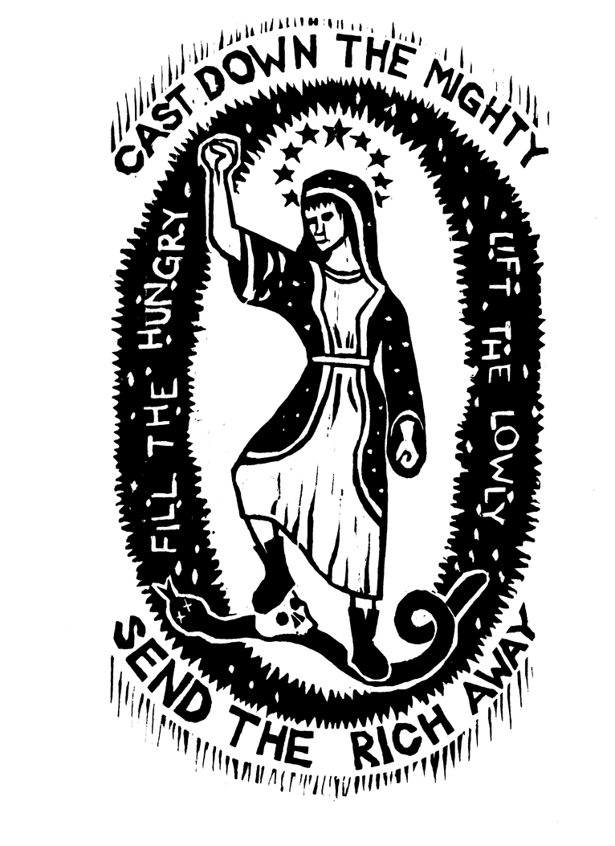
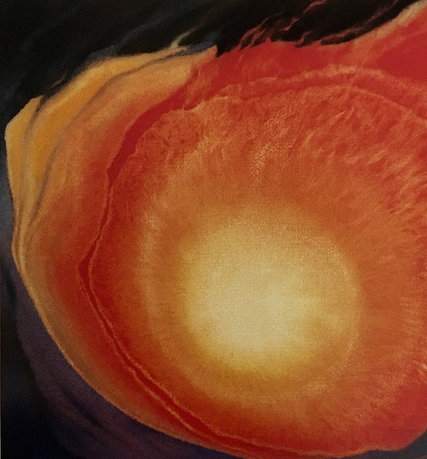
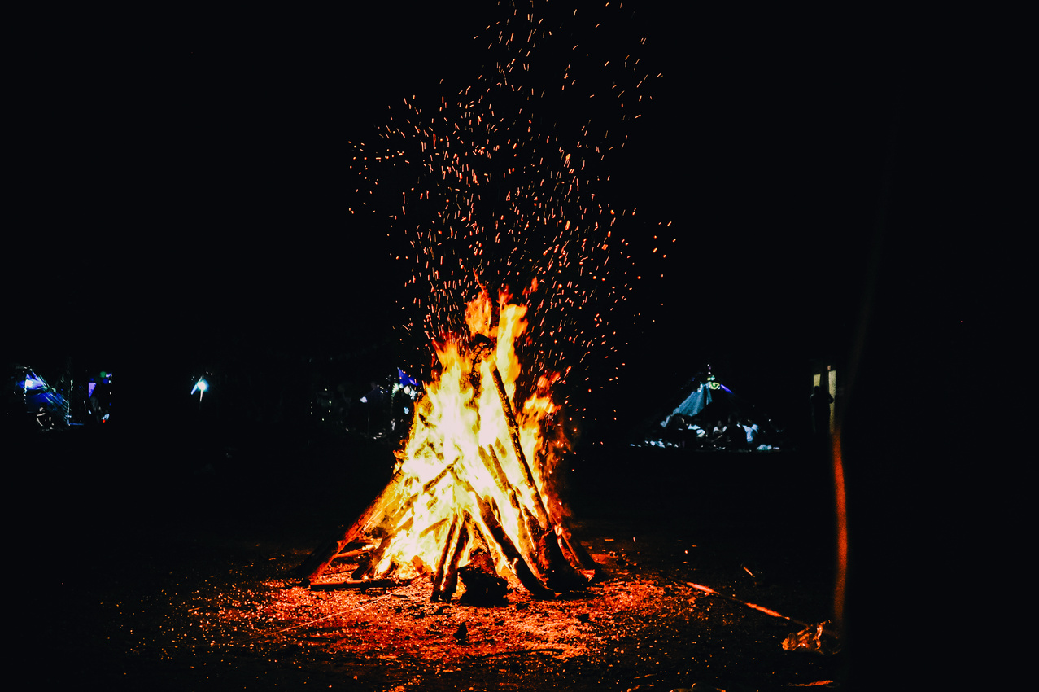
THREE STATIONS ON THE WAY TO THE TABLE
Confession:
What is God burning away within you?
Refining as with fire?
Visio Divina
  Prayerfully gaze at the image of Mary. What do you notice?
  How do you feel as you look at the image? Does it comfort you? Does it challenge you?
  How do you see Mary being transformed? How is God inviting you to be transformed?
Repentance:
Write an idol on a piece of paper (either personal or of your congregation). Then take it to your fire & burn it away.

Slide 19
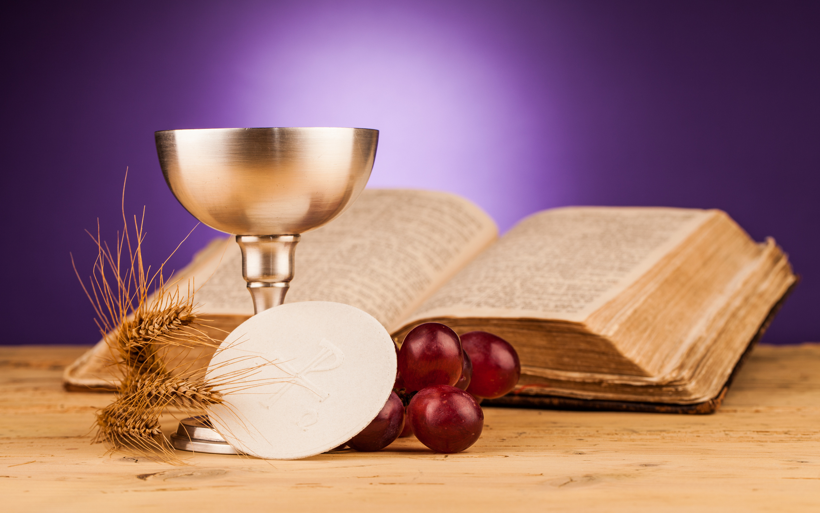
SEALING THE WORD
CELBRANT KAROL NIEHAUS

Slide 20
INVITATION TO THE TABLE
Friends, this is the joyful feast of the people of God!
They will come from east and west,
and from north and south,
and sit at table in the kingdom of God.
According to Luke,
when our risen Lord was at table with his disciples,
he took the bread, and blessed and broke it,
and gave it to them.
Then their eyes were opened
and they recognized him.
This is the Lord’s table.
Our Savior invites those who trust him
to share the feast which he has prepared.

Slide 21
GREAT THANKSGIVING
The Lord be with you.
And also with you.
Lift up your hearts.
We lift them up to the Lord.
Let us give thanks to the Lord our God.
It is right to give our thanks and praise...
Therefore we praise you, joining our voices with the choirs of heaven and with all the faithful of every time and place who forever sing to the glory of your name:
Holy, holy, holy Lord, God of power and might,
heaven and earth are full of your glory.
Hosanna in the highest.
Blessed is he who comes in the name of the Lord.
Hosanna in the highest...

Slide 22
MEMORIAL ACCLAMATION
Great is the mystery of faith:
Christ has died,
Christ is risen,
Christ will come again.

Slide 23
THE LORD’S PRAYER
As Christ our Savior taught us, we are bold to pray:
Our Father who art in heaven, hallowed be thy name.
Thy kingdom come, thy will be done,
on earth as it is in heaven.
Give us this day our daily bread;
and forgive us our debts, as we forgive our debtors;
and lead us not into temptation, but deliver us from evil.
For thine is the kingdom and the power and the glory, forever.
Amen.

Slide 24
BREAKING OF THE BREAD
The Lord Jesus, on the night of his arrest, took bread, and after giving thanks to God, he broke it, and gave it to his disciples, saying:
Take, eat. This is my body, given for you.
Do this in remembrance of me.
In the same way he took the cup, saying:
This cup is the new covenant sealed in my blood,
shed for you for the forgiveness of sins.
Whenever you drink it, do this in remembrance of me.
Every time you eat this bread and drink this cup
you proclaim the saving death of the risen Lord, until he comes.

Slide 25
CLOSING HYMN
#100 “CANTICLE OF THE TURNING” (GTG)

Slide 26
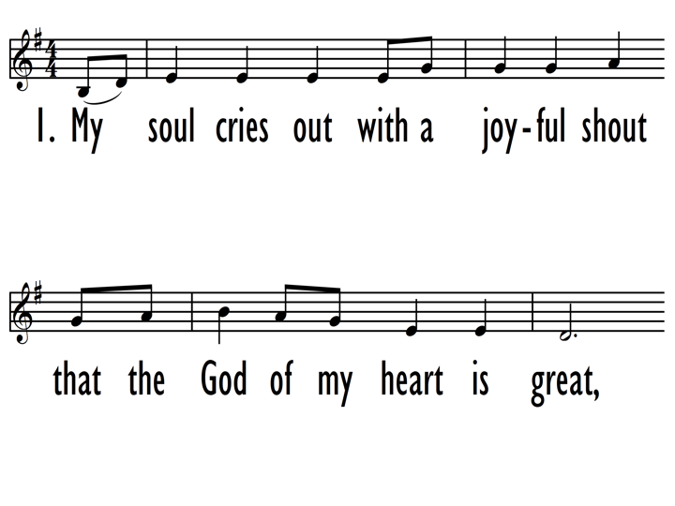

Slide 27
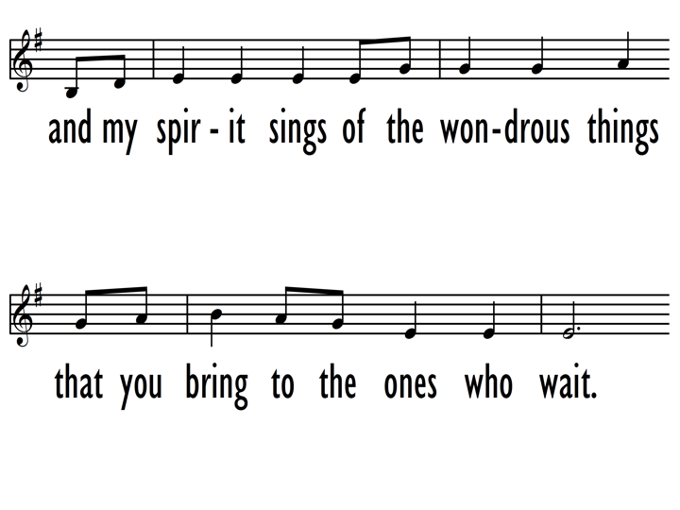

Slide 28
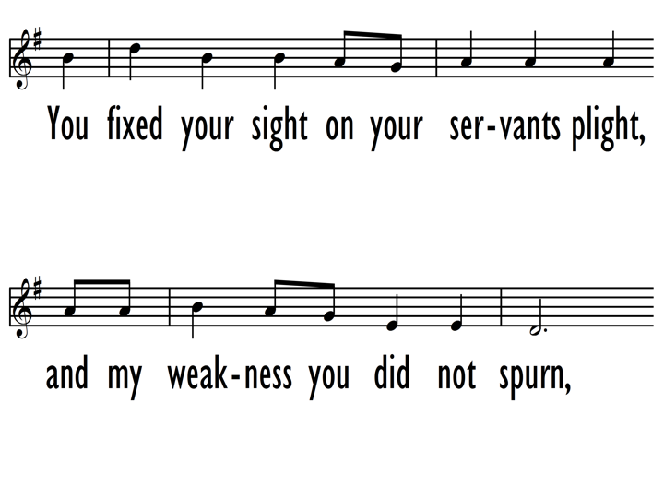

Slide 29
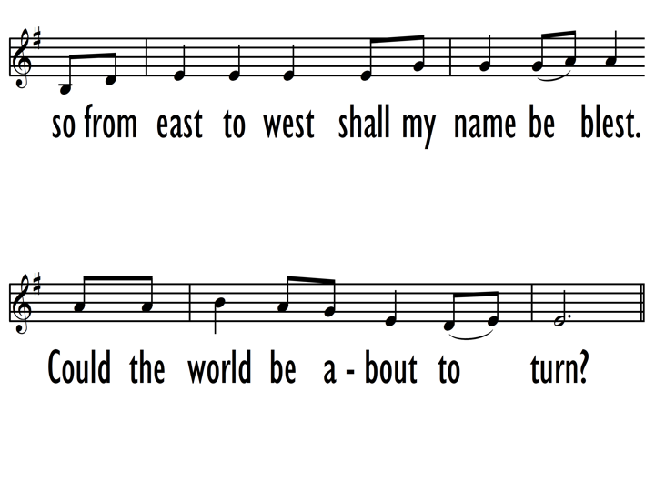

Slide 30
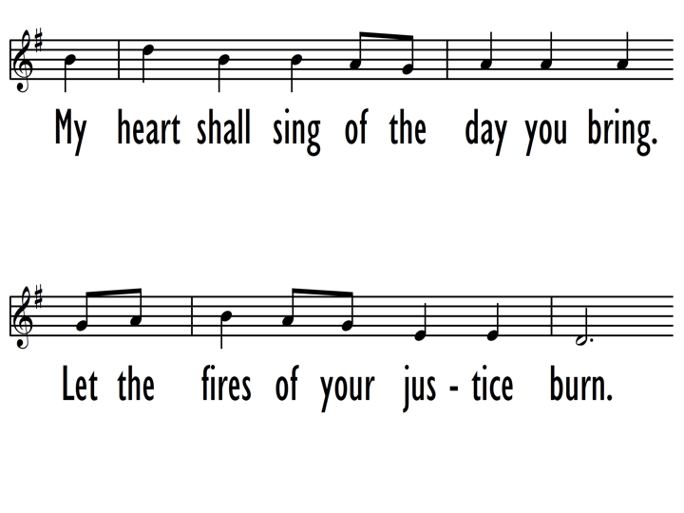

Slide 31
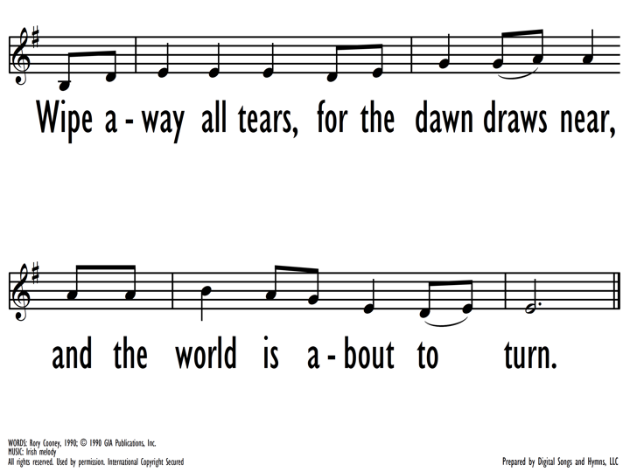

Slide 32
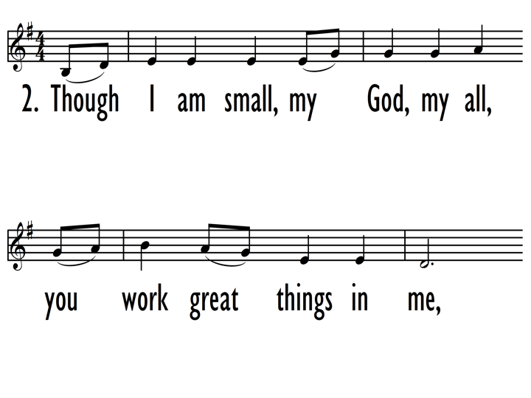

Slide 33
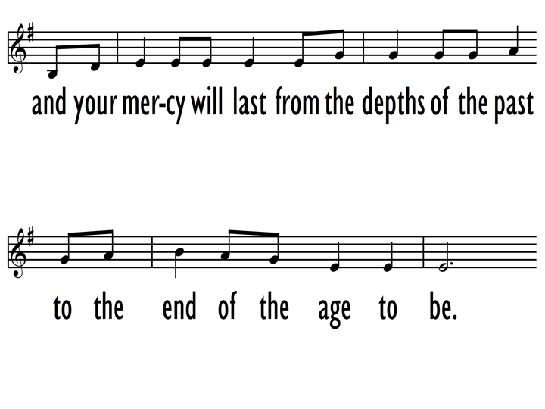

Slide 34
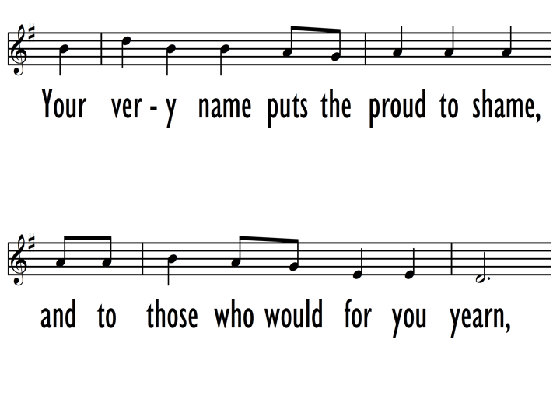

Slide 35
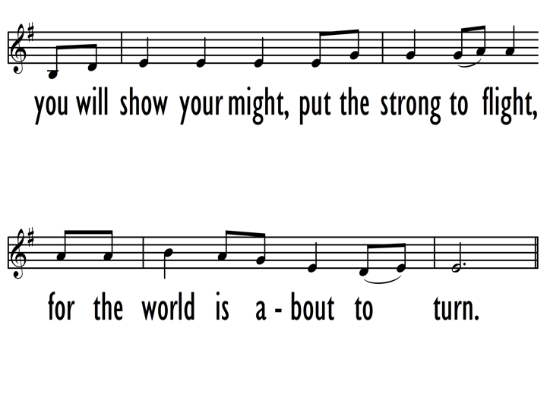

Slide 37
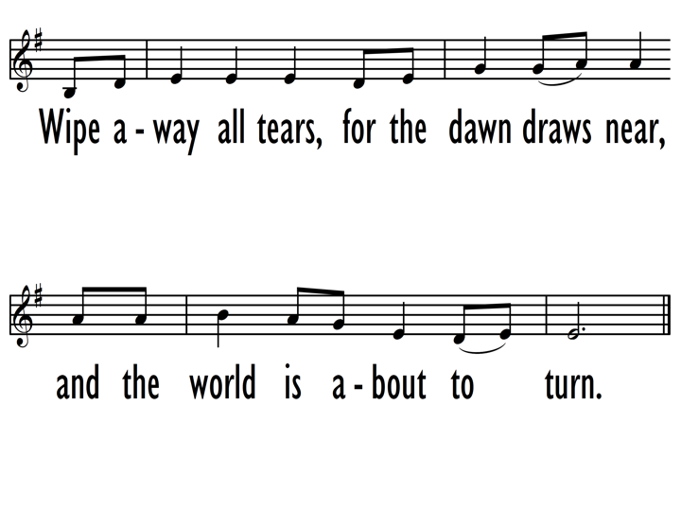

Slide 38
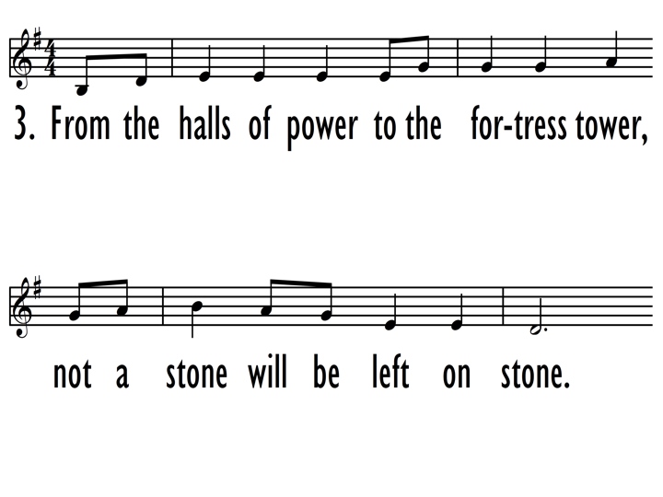

Slide 39
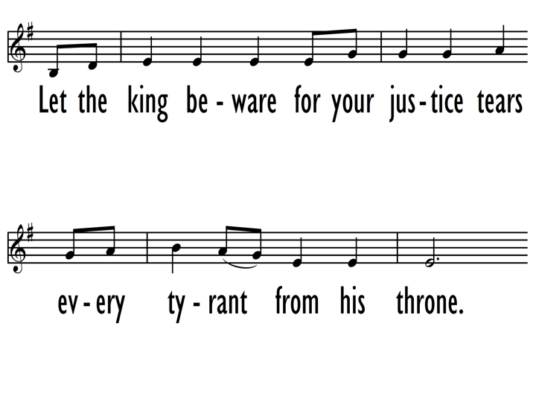

Slide 40
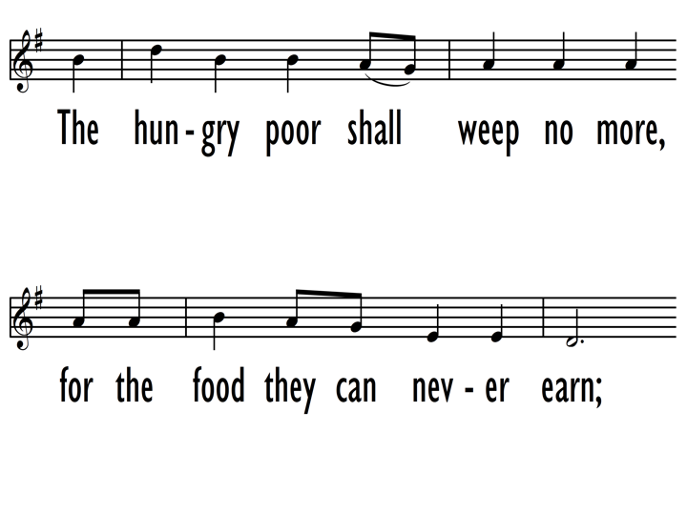

Slide 41
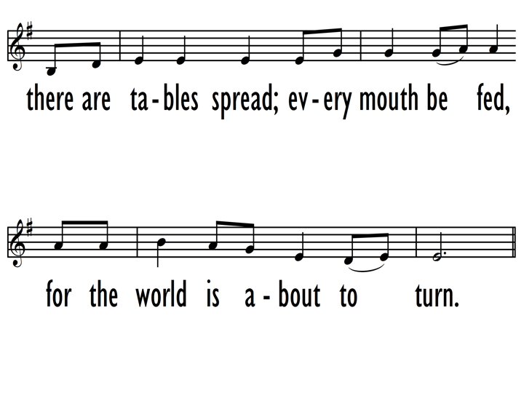

Slide 44
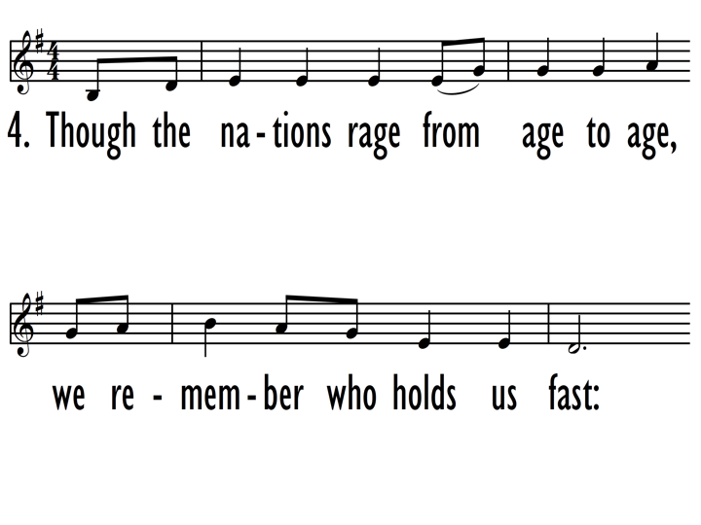

Slide 45
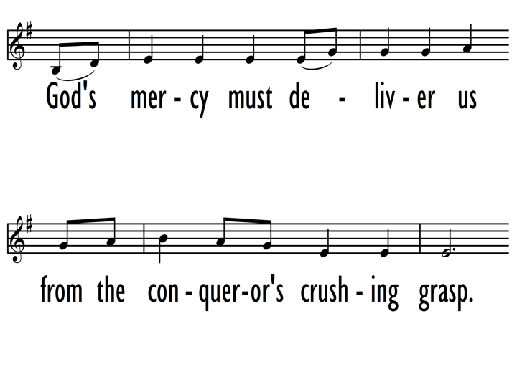

Slide 46
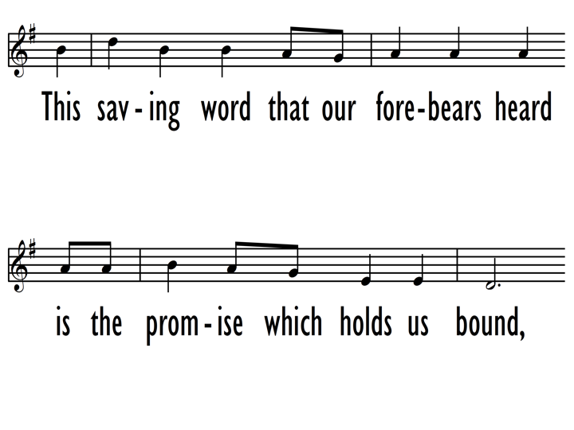

Slide 47
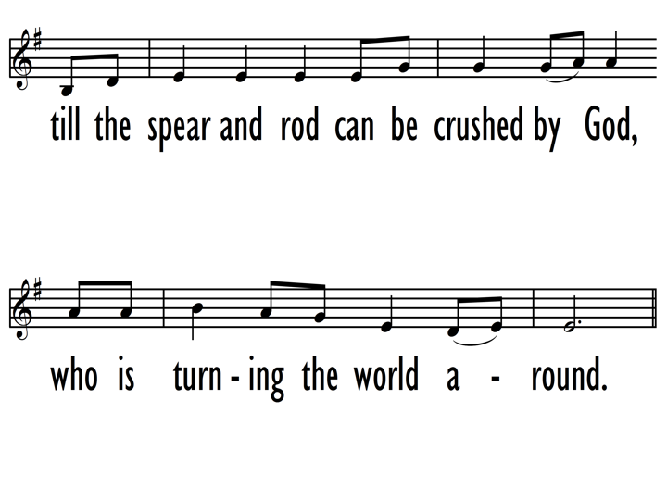

Slide 50
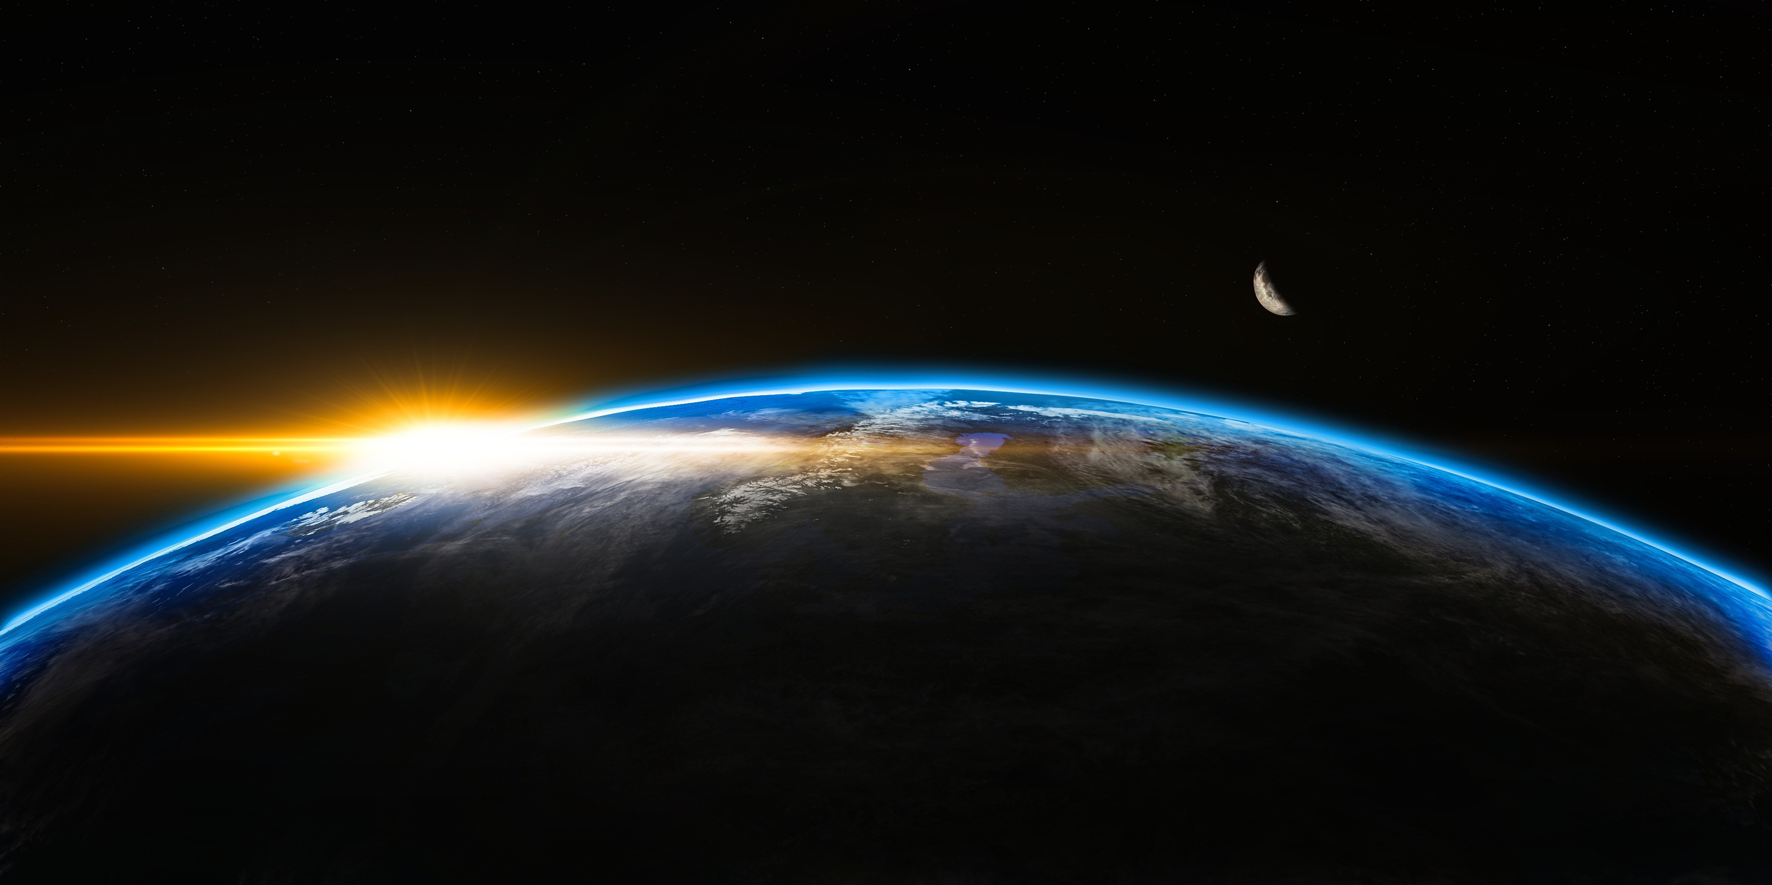
FOLLOWING THE WORD INTO THE WORLD
LITURGIST: REV. ERIN GUZMÁN

