Slide 1
The Synod of the Covenant
Matt Bruce
May 2024

Slide 2
In our Synod, we’ll try anything to equip leaders who tend to God’s emerging, creative future.

Slide 3
2025-2028 Ministry Focus Areas
Supporting and Equipping Leadership for the Church
Strengthening our Most Vulnerable Congregations
Developing Anti-Racist Practices and Structures
Eradicating Systemic Poverty
Connecting Synods, Presbyteries, Congregations, and Leaders

Slide 4
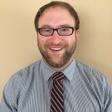
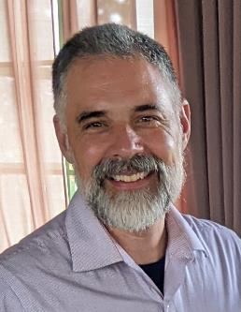
New Synod Ministries
Cultivating the Gift
of Preaching Initiative
Matt Aragon-Bruce
Commissioned Ruling Elders/
Commissioned Pastor Coordinator
Tim Pollock

Slide 5
Higher Education Scholarships for Christian Leaders
Applications Available 6/1/24
Applications Due 9/1/24

Slide 6
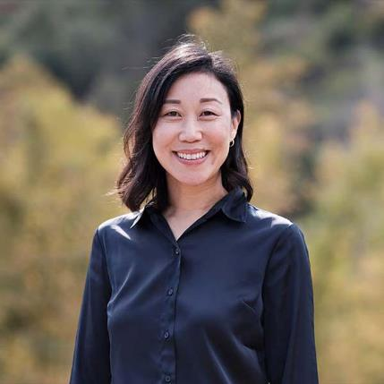
Upcoming Preaching Workshops
June 5
Janette H. Ok
Fuller Seminary
Preaching 1 John
In a Polarized World
First Wednesday of Each Month 10 – 11:30

Slide 7
September 28 9:30-4:30
October 15-16 6:00 to 9:00
November 7 9:30-4:30

Slide 8
Cultivating the Gift of Preaching
Kick off is this June 6-10 at Alma College
We have 23 participants enrolled for this first year
We have about 6-8 people signed up for 2025 already
We hope to have at least 35 new participants in 2025

Slide 9
www.synodofthecovenant.org
Newsletter: www.synodofthecovenant.org/contact
Facebook: Find/Follow “Synod of the Covenant”
Youtube: Subscribe to “Synod of the Covenant”

Slide 10
Matt Bruce
609-712-425
matt@synodofthecovenant.org

