Slide 1
The Synod of the Covenant
September 21, 2024

Slide 2
Higher Education Scholarships for Christian Leaders
46 Applications
8 Presbyteries
22 Congregations
Awardees announced by October 15, 2024

Slide 3
Matthew 25 Grants
Grants Program
Applications Due 9/30/24

Slide 4
The Psychology of Polarization Tuesdays 10/8 and 10/22 10:00 – 11:30 am on Zoom

Slide 5
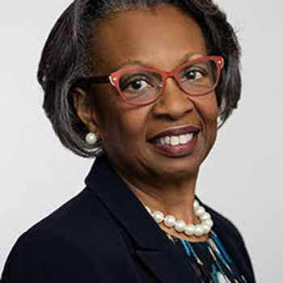
Upcoming Preaching Workshops
October 2
Catherine Williams
Lancaster Seminary
Lyrical Theology
and Hymns as Midrashim
First Wednesday of Each Month 10 – 11:30

Slide 6
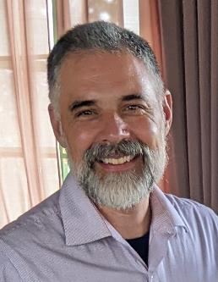
tim@synodofthecovenant.org
Commissioned Ruling Elder/
Commissioned Pastor Coordinator
Tim Pollock

Slide 7
Treasurer (2025-27) Volunteer; ~10 hrs/week

Slide 8
Tim Pollock
740-624-2351
tim@synodofthecovenant.org

Slide 9
www.synodofthecovenant.org
Newsletter: www.synodofthecovenant.org/contact
Facebook: Find/Follow “Synod of the Covenant”
YouTube: Subscribe to “Synod of the Covenant”

